Slide 1
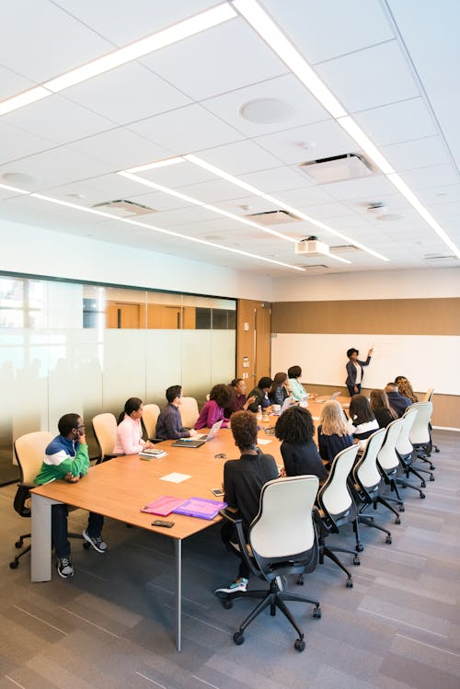


ADULT LEARNING AND EFFECTIVE FACILITATION

Slide 2
Key inquiry questions- Pair.
1. What are the qualities of an effective facilitator/ master trainer?
2. What can you do to improve your facilitation skills?
“Pedagogy of the oppressed”
Lecture method, dictating notes….

Slide 3
Introduction
Teachers need to Re engineer themselves.
Re engineering involves changing two things
Rethinking your MODELS of reality (beliefs)
Improving SYSTEMS for living. (daily habits)
Activity 2. Discuss the common beliefs that may affect what happens in the classroom

Slide 4
Introduction
Adults are a special category of learners; they have special traits and needs. Adults want to know why they need to learn something.
They may ask: ‘Why do I need to know this? or ‘Why is this important?’ Adults want to understand the value.
Adults are autonomous and self-directed; Facilitators should allow the participants to assume responsibility for presentations and group leadership when working in groups.

Slide 5

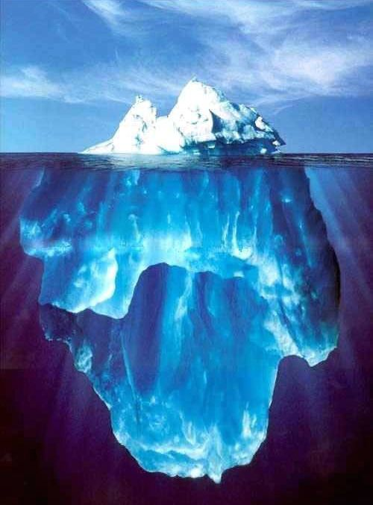
The iceberg principle
ONLY 10% OF ANY ICEBERG IS VISIBLE. THE REMAINING 90% IS BELOW SEA LEVEL
Think of the 90% of things you can’t see directly in your learner

Slide 6
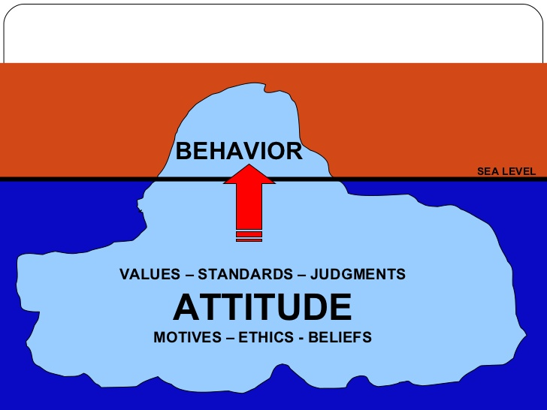
Application to Facilitation

Slide 7

Act. 3.What is to Transform?

Slide 8
PRINCIPLES OF ADULT LEARNING
Adults are autonomous and self-directed. Trainees/participants should be allowed to assume responsibilities for presentations and group discussion
They are problem/issue centred- talk be around issues or problems
Adults are goal oriented. The objectives should be outlined to the trainees, they appreciate organization and clearly defined elements
Adults are practical.
The trainees/participants should be told how the lesson is useful to them in a practical perspective
5) Adults should be treated as equals.
They should be allowed to express their opinions freely.
8

Slide 9
Principles Of Adult Learning cont..
Make sure your adult participants understand “Why” - why each thing you teach them is an important part of the learning and their work
Allow your participants to experience what they’re learning - activities that get your participants involved makes the learning experiential
Encourage your adult participants - inspire confidence and passion in another person
define our core message- how inspiring? Shift in mindset, drive behavioral change.

Slide 10
QUALITIES OF A GOOD TRAINER
It requires training and continuous practice to be able to improve one’s training and facilitation skills.
Professionalism. Carry out training with a high degree of confidence and maturity. Image of a teacher. Know self-dressing, collegiality, honesty, accountability
Effective communication skills. Be able to transmit knowledge to the audience effectively, listening and speaking.
Democratic. Give trainees opportunity to talk freely
Results oriented. Elements of tenacity should be emphasized in achieving goals
Good organization skills. Good organization helps you see through the entire process smoothly

Slide 11
Facilitators we dread
The drill sergeant - the facilitator who is rigidly stuck on the agenda and puts the clock above content.
The guardian – the facilitators who makes certain that all conversation goes through him/her and not from participant to participant.
The know-it-all – this is the facilitator who always has the answer and does not allow the participant to generate their knowledge.-be comfortable with not knowing
The blabber – the facilitator who loves the sound of his/her own voice-talks, talks and talks.
The ice cube facilitator – He is distant, aloof and willing to personalize the experience.-unfriendly
The marathoner - he piles activities upon one another, does not allow breaks and ignores the need of participants.

Slide 12
Facilitators we dread cont…
The parrot- he/she relentlessly repeats himself/herself and summarizes the obvious
The passenger – (s)he lets people talk for too long and gives up the reigns of facilitation (losses control); just passing time
9. The storyteller – tells far too many story without getting to the content
10. The center-piece – makes themselves the real content of the workshop. –avoid talking too much about yourself

Slide 13
Facilitators we dread cont.
11 . Overly Critical Facilitators- negative feedback, lack of encouragement, discouraging
12. Monotonous Facilitators- dull delivery, lack of interaction
13. Overly Authoritative Facilitators-Intimidating Presence, Lack of Flexibility, unapproachable
  Activity 3.
  Share any experiences about a facilitator you dreaded. Why did you dread the facilitator?

Slide 14
Useful Tips
Remember that you will be training adult participants:
Define your core message- Inspiring, shift mindset
Understand the participants-needs, knowledge, pain points, beliefs, open to change?
Be Prepared-content, technical setup, resources
Enforce positive and respectful interaction
Maintain a balance of content and process
Offer encouragement, praise, and recognition
Communicate clearly- speak, body language, eye contact, gestures, use of space.
Be positive, enthusiastic, and focused etiquette

Slide 15
Useful Tips
Maintain a Positive Attitude-confidence and encouragement consistently
Ask open-ended questions and listen carefully
Trust your participants to have good ideas
Keep participation balanced-engage all
Practice Active Listening- feedback, flexible
Have a sense of humour. Sense of closure or a call to action.
Go beyond facilitation and touch the learner.

Slide 16
Tips cont.
Structure your presentations- Hook –surprise facts, personal story, KIQs, deal with negativity, motivation, growth mindset
Design visuals-inspire, evoke emotions, videos
Use persuasive techniques-story telling, Rhetorical questions, statistics, repetition
Engage the audience emotionally
End with memorable close.

Slide 17
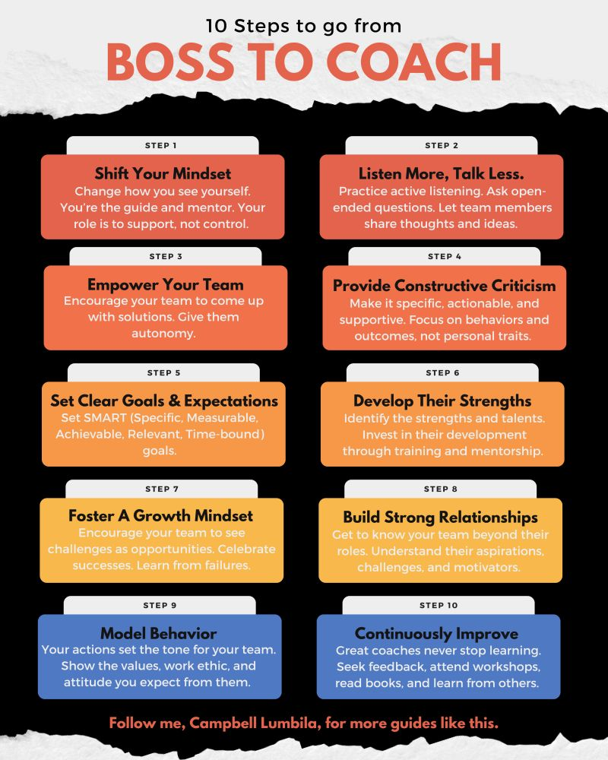

Slide 18
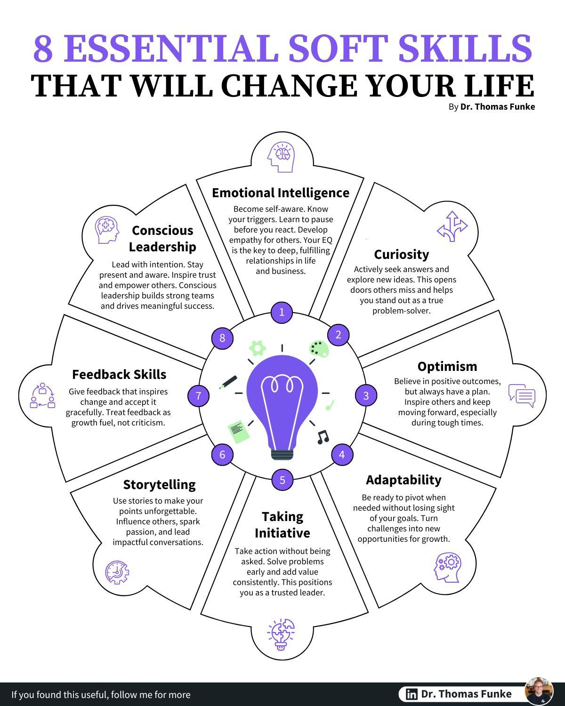

Slide 19
The late Geoffrey Griffins- “Education for a free man”
20 June 2005
Let us educate our teachers /learners to be independent thinkers

Slide 20
The End
Thank You

